Slide 1
Unit Testing Javascript
(with Karma & Jasmine)

Slide 2
Agenda
Introduction
Tools
Jasmine
Karma
Jest
Demonstration
More Tools
Package Management: Node/NPM
Loaders: RequireJS or Browserify
Going forward
Maven/CI integration

Slide 3
Introduction
Overview of different methods to test javascript code
Skims the surface
Let us know if one of the topics would be worth another brown bag

Slide 4

Why Unit Testing?

Slide 5
Why Unit Testing?
Unit Tests allows you to make big changes to code quickly. You know it works now because you’ve run the tests, when you make the changes you need to make, you need to get the tests working again.
TDD helps you to realize when to stop coding. Your tests give you confidence that you've done enough for now and can stop tweaking and move on to the next thing.
Unit Tests give you instant visual feedback, we all like the feeling of all those green lights when we've done. It's very satisfying. It's also much easier to pick up where you left off after an interruption because you can see where you got to - that next red light that needs fixing.
Good unit tests can help document and define what something is supposed to do.
http://stackoverflow.com/a/67500

Slide 6


Slide 7
Jasmine
Jasmine is an open source testing framework for JavaScript. It aims to run on any JavaScript-enabled platform, to not intrude on the application nor the IDE, and to have easy-to-read syntax. It is heavily influenced by other unit testing frameworks, such as ScrewUnit, JSSpec, JSpec, and RSpec.
De facto standard for javascript testing
https://en.wikipedia.org/wiki/Jasmine_%28JavaScript_framework%29

Slide 8
Jasmine
Example:
describe('Hello world', function() {
it('says hello', function() {
expect(helloWorld()).toEqual("Hello world!");
});
});
Missing concept of spies (like mocks – kinda)
A spy can stub any function and tracks calls to it and all arguments.

Slide 9


Slide 10
Karma
Karma is essentially a tool which spawns a web server that executes source code against test code for each of the browsers connected. The results for each test against each browser are examined and displayed via the command line to the developer such that they can see which browsers and tests passed or failed.

Slide 11
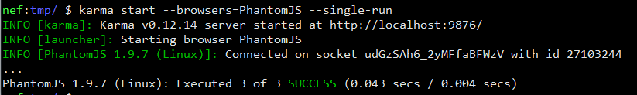
Karma

Slide 12
Jest
http://facebook.github.io/jest/
Familiar Approach: Built on top of the Jasmine test framework, using familiar expect(value).toBe(other) assertions
Mock by Default: Automatically mocks CommonJS modules returned by require(), making most existing code testable
Short Feedback Loop: DOM APIs are mocked and tests run in parallel via a small node.js command line utility

Slide 13
Jest
Example:
// sum.js
function sum(value1, value2) {
return value1 + value2;
}
module.exports = sum;
// __tests__/sum-test.js
jest.dontMock('../sum');
describe('sum', function() {
it('adds 1 + 2 to equal 3', function() {
var sum = require('../sum');
expect(sum(1, 2)).toBe(3);
});
});

Slide 14
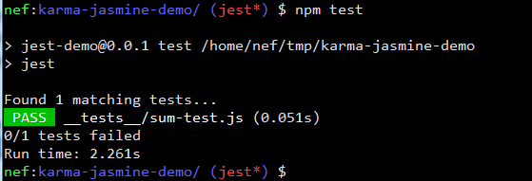
Jest

Slide 15
Demonstration
Code available:
https://github.com/n3f/karma-jasmine-demo
a.k.a. http://git.io/pie4sA
Master branch
Adapted from http://osintegrators.com/testing-javascript-with-karma
Backbone based web application structure
Jest branch
From the jest documentation

Slide 16
Javascript Loaders
RequireJS (AMD)
CommonJS
For more information
http://addyosmani.com/writing-modular-js/

Slide 17
RequireJS (AMD)
RequireJS is a JavaScript file and module loader. It is optimized for in-browser use, but it can be used in other JavaScript environments, like Rhino and Node. Using a modular script loader like RequireJS will improve the speed and quality of your code.
Example:
// define a module
//Inside file my/shirt.js:
define({
color: "black",
size: "unisize“
});
// In main.js
require([‘my/shirt.js’],function(shirt) {
alert(shirt.color); // black
});

Slide 18
Browserify (CommonJS)
Browsers don't have the require method defined, but Node.js does. With Browserify you can write code that uses require in the same way that you would use it in Node.
Example:
// Create a module like any node module. (e.g. hi.js)
module.exports = function() {
return “Hello World!”;
}
// in main.js
var hello = require(‘hi.js’);
alert(hello()) // returns “Hello World!”
Browserify will create one js file for you
browserify main.js –o bundle.js

Slide 19

Where do I go from here?

Slide 20
Where do I go from here
Start using these tools in your projects
Identify the pain points
Integrate with CI (Jenkins) (Karma’s web site has a page about doing this)
Hold a brown bag to share what you’ve found
Aztec
http://searls.github.io/jasmine-maven-plugin/plugin-info.html
Integrating into a large pre-existing javascript base is difficult
Notes:
I had a problem getting jasmine-maven-plugin working because our nexus server was not reading correctly from the maven central repository.

